Slide 1
Lexical Analysis

Slide 2
The Role of the Lexical Analyzer
The lexical analyzer is to read the input characters of the source program, group them into lexemes, and produce as output a sequence of tokens for each lexeme in the source program.
The stream of tokens is sent to the parser for syntax analysis.
It is common for the lexical analyzer to interact with the symbol table as well.
When the lexical analyzer discovers a lexeme constituting an identifier, it needs to enter that lexeme into the symbol table.
In some cases, information regarding the kind of identifier may be read from the symbol table by the lexical analyzer to assist it in determining the proper token it must pass to the parser.

Slide 3
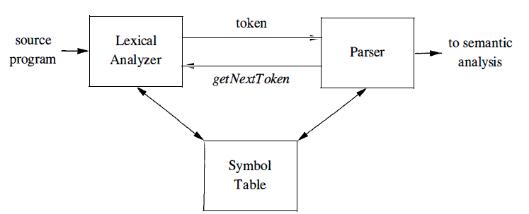
Interaction between the lexical analyzer & the parser

Slide 4
Other Tasks:
Stripping out comments and whitespace (blank, newline, tab, and perhaps other characters that are used to separate tokens in the input).
Correlating error messages generated by the compiler with the source program.

Slide 5
Divided into two processes
1. Scanning consists of the simple processes that do not require tokenization of the input, such as deletion of comments and compaction of consecutive whitespace characters into one.
2. Lexical analysis proper is the more complex portion, where the scanner produces the sequence of tokens as output.

Slide 6
Lexical Analysis Versus Parsing
Why the analysis portion of a compiler is normally separated into lexical analysis and parsing (syntax analysis) phases?
Simplicity of design is the most important consideration.
The separation of lexical & syntactic analysis often allows us to simplify at least one of these tasks.
If we are designing a new language, separating lexical & syntactic concerns can lead to a cleaner overall language design.

Slide 7
2. Compiler efficiency is improved.
A separate lexical analyzer allows us to apply specialized techniques that serve only the lexical task, not the job of parsing.
In addition, specialized buffering techniques for reading input characters can speed up the compiler significantly.
3. Compiler portability is enhanced. Input-device-specific peculiarities can be restricted to the lexical analyzer.

Slide 8
Tokens, Patterns & Lexemes
Token
a token name + an optional attribute value.
The token name is an abstract symbol representing a kind of lexical unit, e.g., a particular keyword, or a sequence of input characters denoting an identifier.
The token names are the input symbols that the parser processes.

Slide 9
Pattern
A pattern is a description of the form that the lexemes of a token may take.
In the case of a keyword as a token, the pattern is just the sequence of characters that form the keyword.
For identifiers & some other tokens, the pattern is a more complex structure that is matched by many strings.
Lexemes
A lexeme is a sequence of characters in the source program that matches the pattern for a token & is identified by the lexical analyzer as an instance of that token.

Slide 10
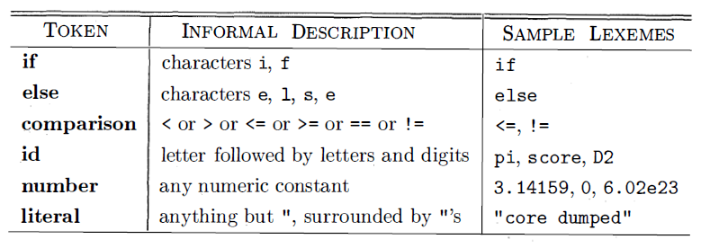
Example: Patterns & Lexemes
C statement
printf ("Total = %d\n" , score ) ;
both printf and score are lexemes matching the pattern for token id, and " Total = %d\n" is a lexeme matching literal.

Slide 11
Covering most or all of the tokens
1. One token for each keyword. The pattern for a keyword is the same as the keyword itself.
2. Tokens for the operators, either individually or in classes.
3. One token representing all identifiers.
4. One or more tokens representing constants, such as numbers & literal strings.
5. Tokens for each punctuation symbol, such as left &right parentheses, comma, & semicolon.

Slide 12
Attributes for Tokens
When more than one lexeme can match a pattern, the lexical analyzer must provide the subsequent compiler phases additional information about the particular lexeme that matched.
For example, the pattern for token number matches both 0 and 1, but it is extremely important for the code generator to know which lexeme was found in the source program.
Thus, in many cases the lexical analyzer returns to the parser not only a token name, but an attribute value that describes the lexeme represented by the token ;
Token name influences parsing decisions, while the attribute value influences translation of tokens after the parse.

Slide 13
Attributes for Tokens
Tokens have at most one associated attribute, although this attribute may have a structure that combines several pieces of information.
Normally, information about an identifier-e.g., its lexeme, its type, and the location at which it is first found is kept in the symbol table.
Thus, the appropriate attribute value for an identifier is a pointer to the symbol-table entry for that identifier.

Slide 14
Example 3.2 : The token names & associated attribute values for the Fortran statement E = M * C ** 2
Sequence of pairs:
<id, pointer to symbol-table entry for E>
<assign_op> [no need to assign]
<id, pointer to symbol-table entry for M>
<mult_op> [no need to assign]
<id, pointer to symbol-table entry for C>
<exp_op> [no need to assign]
<number, integer value 2>

Slide 15
Lexical Errors
It is hard for a lexical analyzer to tell, without the aid of other components, that there is a source-code error.
For instance, if the string fi is encountered for the first time in a C program in the context :
fi ( a == f (x) ) . . .
A lexical analyzer cannot tell whether fi is a misspelling of the keyword if or an undeclared function identifier.
Since fi is a valid lexeme for the token id, the lexical analyzer must return the token id to the parser

Slide 16
Lexical Errors
Let the parser - handle an error due to transposition of the letters.
However, suppose a situation arises in which the lexical analyzer is unable to proceed because none of the patterns for tokens matches any prefix of the remaining input.
Error Recovery
The simplest recovery strategy is "panic mode" recovery.
We delete successive characters from the remaining input, until the lexical analyzer can find a well-formed token at the beginning of what input is left.
This recovery technique may confuse the parser, but in an interactive computing environment it may be quite adequate.

Slide 17
Other Recovery
1. Delete one character from the remaining input.
2. Insert a missing character into the remaining input.
3. Replace a character by another character.
4. Transpose two adjacent characters.

Slide 18
Terms for Parts of Strings
1 . A prefix of string s is any string obtained by removing zero or more symbols from the end of s.
ban, banana, and ε are prefixes of banana.
2. A suffix of string s is any string obtained by removing zero or more symbols from the beginning of s.
nana, anana, and ε are suffixes of banana.
3. A substring of s is obtained by deleting any prefix and any suffix from s.
banana, nan, and ε are substrings of banana.
4. The proper prefixes, suffixes, and substrings of a string s are those, prefixes, suffixes, and substrings, respectively, of s that are not ε or not equal to s itself.
5. A subsequence of s is any string formed by deleting zero or more not necessarily consecutive positions of s.
baan is a subsequence of banana.

Slide 19
Regular Expressions
Regular expressions: underscore is included among the letters.
if letter_ is established to stand for any letter or the underscore, and digit_ established to stand for any digit, then we could describe the language of C identifiers by :
Letter_ ( letter_ | digit )*
Vertical bar: union
Parentheses: group sub expressions,
Star: zero or more occurrences of
Juxtaposition of letter_ with the remainder of the expression signifies concatenation

Slide 20
Each regular expression r denotes a language L(r) , which is also defined recursively from the languages denoted by r's sub expressions.

Slide 21
Rules that define the regular expressions over some alphabet Σ and the languages that those expressions denote.

Slide 22
BASIS: There are two rules
1. ε is a regular expression, and L (ε) is {ε}
the language whose sole member is the empty string.
2. If a is a symbol in Σ, then a is a regular expression, and L(a) = {a},
the language with one string, of length one, with a in its one position.

Slide 23
INDUCTION: There are 04 parts to the induction whereby larger regular expressions are built from smaller ones. Suppose r and s are regular expressions denoting languages L(r) and L(s).
1. (r)|(s) is a regular expression denoting the language L(r) U L(s) .
2. (r) (s) is a regular expression denoting the language L(r)L(s).
3. (r)* is a regular expression denoting (L (r)) * .
4. (r) is a regular expression denoting L(r) .
This last rule says that we can add additional pairs of parentheses around expressions without changing the language they denote.

Slide 24
We may drop certain pairs of parentheses
Conventions
a) The unary operator * has highest precedence & is left associative.
b) Concatenation has second highest precedence and is left associative.
c) I has lowest precedence and is left associative.
(a) I((b) *(c)) == alb* c.
Both expressions denote the set of strings that are either a, single a or are zero or more b's followed by one c.

Slide 25
Example 3.4 : Let Σ = {a, b} .
1. The regular expression a|b denotes the language {a, b} .
2. (alb) (alb) denotes {aa, ab, ba, bb} , the language of all strings of length two over the alphabet Σ. Another regular expression for the same language : aa l ab l ba l bb
3. a* denotes the language consisting of all strings of zero or more a's: {ε, a, aa, aaa, ... }.
4. ( a I b) * denotes the set of all strings consisting of zero or more instances of a or b,
all strings of a's and b's: {ε , a, b, aa, ab, ba, bb, aaa, ... }.
Another regular expression for same language: (a* b * )*.
5. ala* b denotes the language {a, b, ab, aab, aaab, ... },
the string a & all strings consisting of zero or more a's & ending in b.

Slide 26
Regular set: A language that can be defined by a regular expression
If two regular expressions r and s denote the same regular set , we say they are equivalent and write r = s. For instance, (alb) = (b la).

Slide 27
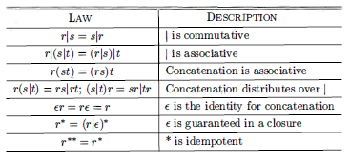
Algebraic laws for regular expressions r, s, & t

Slide 28
Regular Definition
If Σ is an alphabet of basic symbols, then a regular definition is a sequence of definitions of the form:
d₁ → r₁
d₂ → r₂
₋₋₋₋₋₋
D_{n} → r_{n}

Slide 29
1. Each d_{i} is a new symbol, not in Σ and not the same as any other of the d's,
2. Each r_{i} is a regular expression over the alphabet ΣU {d₁ , d₂ , . . . , d_{i-1}
By restricting r_{i} to Σ & previously defined d's, we avoid recursive definitions, and we can construct a regular expression over Σ alone, for each r_{i}
How: first replacing uses of d₁ in r₂ (which cannot use any of the d's except for d₁), then replacing uses of d₁ and d₂ in r₃ by r₁ and (the substituted) r₂ , and so on.
Finally, in r_{n} replace each d_{i} , for i = 1 , 2, . . . , n - 1 , by the substituted version of r_{i} , each of which has only symbols of Σ.

Slide 30
Example: C identifiers are strings of letters, digits, and underscores. Here is a regular definition for the language of C identifiers. We shall conventionally use italics for the symbols defined in regular definitions.
letter → A I B I · · · l z l a l b l · · · l z l –
digit → 0| 1 | · · ·| 9
id → letter _ ( letter- I digit ) *

Slide 31
Example : Unsigned numbers (integer or floating point) are strings such as 5280, 0 . 0 1234, 6 . 336E4, or 1 . 89E-4.
digit → 0| 1 |· · · | 9
digits → digit digit*
optionalFraction → . digits I ε
optionalExponent → ( E ( + I - I ε ) digits ) I ε
number → digits optionalFraction optionalExponent

Slide 32
Abbreviations
The basic operations generate all possible regular expressions, but there are common abbreviations used for convenience. Typical examples:
Abbr. | Meaning | Notes
r+ | (rr*) | 1 or more occurrences
r? | (r | ε) | 0 or 1 occurrence
[a-z] | (a|b|…|z) | 1 character in given range
[abxyz] | (a|b|x|y|z) | 1 of the given characters

Slide 33
Examples
re | Meaning
+ | single + character
! | single ! character
= | single = character
!= | 2 character sequence
<= | 2 character sequence
xyzzy | 5 character sequence

Slide 34
Extensions of Regular Expressions
1 . One or more instances. The unary, postfix operator + represents the positive closure of a regular expression and its language.
That is, if r is a regular expression, then (r)⁺ denotes the language (L(r) ) ⁺ .
The operator + has the same precedence and associativity as the operator *
Two useful algebraic laws, r* = r⁺ |e and r⁺ = rr* = r*r relate the Kleene closure & positive closure.
2. Zero or one instance. The unary postfix operator ? means "zero or one occurrence." That is, r? is equivalent to r l ε , or put another way, L (r?) = L (r) U {ε}.
The ? operator has the same precedence and associativity as * and + .
3. Character classes. A regular expression a₁l a₂| · · · I a_{n} , where the a_{i} 's are each symbols of the alphabet, can be replaced by the shorthand [a₁ a₂ · · · a_{n}].
when a₁ , a₂ , . · · , a_{n} form a logical sequence, e.g., consecutive uppercase letters, lowercase letters, or digits, we can replace them by a₁-a_{n} , that is, just the first and last separated by a hyphen.
[abc] == a|b|c, [a-z] == a|b| · · · |z

Slide 35
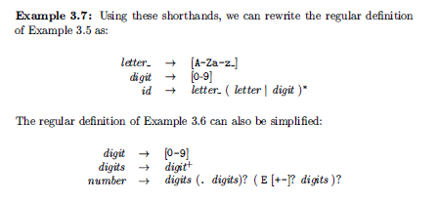

Slide 36
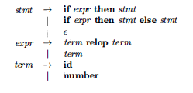
Recognition of Tokens
Build a piece of code that examines the input string & finds a prefix that is a lexeme matching one of the patterns.

Slide 37
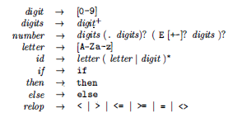
Example:
Terminals:
if, then, else, relop , id,
number---names of tokens
Patterns
ws → ( blank | tab | newline )⁺
blank, tab, newline are abstract symbols.
Token ws is different from the other tokens in that , when we recognize it, we do not return it to the parser, but rather restart the lexical analysis from the character that follows the whitespace.

Slide 38
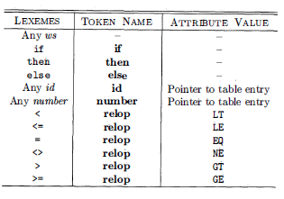
Tokens, their patterns, and attribute values
For each lexeme or family of lexemes, which token name is returned to the parser and what attribute value, is returned.
06 relational operators are used as the attribute value, in order to indicate which instance of the token relop we have found

Slide 39
Transition Diagrams
convert patterns into stylized flowcharts: "transition diagrams"
Transition diagrams have a collection of nodes or circles, called states.
Each state represents a condition that could occur during the process of scanning the input looking for a lexeme that matches one of several patterns.

Slide 40
Transition Diagrams
Edges are directed from one state to another.
Each edge is labeled by a symbol or set of symbols.
If we are in some state s , & the next input symbol is a, we look for an edge out of state s labeled by a (and perhaps by other symbols, as well).
If such an edge found, advance the forward pointer & enter the state of the transition diagram to which that edge leads.
transition diagrams are deterministic
there is never more than one edge out of a given state with a given symbol among its labels.

Slide 41
Some important conventions
1. Certain states are said to be accepting, or final. These states indicate that a lexeme has been found. We always indicate an accepting state by a double circle, and if there is an action to be taken - typically returning a token and an attribute value to the parser - we shall attach that action to the accepting state.
2. In addition, if it is necessary to retract the forward pointer one position (i.e., the lexeme does not include the symbol that got us to the accepting state), then we shall additionally place a* near that accepting state.
3. One state is designated the start state, or initial state; it is indicated by an edge, labeled "start," entering from nowhere. The transition diagram always begins in the start state before any input symbols have been read.

Slide 42
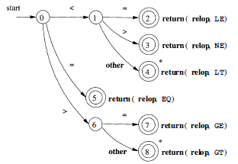
Example: Transition diagram that recognizes the lexemes matching the token relop.

Slide 43

Recognition of Reserved Words and Identifiers
Keywords (if or then) are reserved
not identifiers
Transition diagram for identifier lexemes, & recognize the keywords if , then, & else

Slide 44
02 ways that we can handle reserve words that look like identifier
Install the reserved words in the symbol table initially. A field of the symbol-table entry indicates that these strings are never ordinary identifiers, and tells which token they represent.
When we find an identifier, a call to installID places it in the symbol table if it is not already there and returns a pointer to the symbol-table entry for the lexeme found. The function gettoken() examines the lexeme and returns the token name, either id or a name corresponding to a reserved keyword.

Slide 45

2. Create separate transition diagrams for each keyword;
Note that such a transition diagram consists of states representing the situation after each successive letter of the keyword is seen, followed by a test for a "nonletter-or-digit,“ i.e., any character that cannot be the continuation of an identifier.
Hypothetical transition diagram for the keyword then

Slide 46
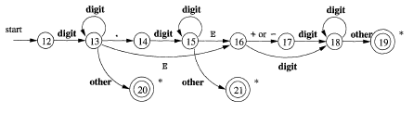

Figure : A transition diagram for unsigned numbers
Figure : A transition diagram for whitespace

Slide 47
Finite Automata
Finite automata are essentially graphs, like transition diagrams, with a few differences:
1. Finite automata are recognizers; they simply say "yes" or "no" about each possible input string.
2. Finite automata come in two flavors:
(a) Nondeterministic finite automata (NFA) have no restrictions on the labels of their edges. A symbol can label several edges out of the same state, and ε, the empty string, is a possible label.
(b) Deterministic finite automata (DFA) have, for each state, and for each symbol of its input alphabet exactly one edge with that symbol leaving that state.
Both NFA & DFA are capable of recognizing the same languages (regular language)

Slide 48
Nondeterministic Finite Automata (NFA)
1 . A finite set of states S.
2. A set of input symbols Σ, the input alphabet. The empty string (ε), is never a member of Σ
3. A transition function that gives, for each state, and for each symbol in Σ U {E} a set of next states.
4. A state s₀ from S that is distinguished as the start state (or initial state) .
5. A set of states F, a subset of S, that is distinguished as the accepting states (or final states) .

Slide 49
Any NFA/DFA can represent by a transition graph, where the nodes are states and the labeled edges represent the transition function.
There is an edge labeled a from state s to state t
if and only if t is one of the next states for state s and input a .
This graph is very much like a transition diagram, except
a) The same symbol can label edges from one state to several different states,
b) An edge may be labeled by ε, the empty string, instead of, or in addition to, symbols from the input alphabet.

Slide 50

Example: R = (alb) * abb
NFA
Double circle around state 3 indicates that this state is accepting.
only ways to get from the start state 0 to the accepting state is to follow some path that stays in state 0 for a while, then goes to states 1 , 2, and 3 by reading abb from the input.
Thus, the only strings getting to the accepting state are those that end in abb.

Slide 51
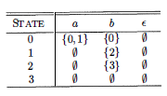
Transition Tables
Rows : states
Columns: input symbols and ε.
The entry for a given state & input is value of the transition function applied to those arguments.
If the transition function has no information about that state-input pair, put Φ.
Adv: Easily find the transitions on a given state and input.
Disadv: takes a lot of space, when the input alphabet is large,

Slide 52
Acceptance of Input Strings by Automata
An NFA accepts input string x if & only if there is some path in the transition graph from the start state to one of the accepting states
ε labels along the path are effectively ignored, since the empty string does not contribute to the string constructed along the path.

Slide 53
Example : The string aabb is accepted by the NFA
Another path (not accepting)
NFA accepts a string as long as some path labeled by that string leads from the start state to an accepting state.
NFA

Slide 54
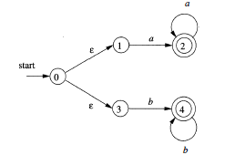
L(aa* | bb* )
String aaa accepted
ε is "disappear" in a concatenation

Slide 55
Example: Moves on a Chessboard
States = squares.
Inputs = r (move to an adjacent red square) and b (move to an adjacent black square).
Start state, final state are in opposite corners.

Slide 56
Example: Chessboard – (2)
1
2
3
r b
2,4 5
4,6 1,3,5
2,6 5
2,8 1,5,7
2,4,6,8 1,3,7,9
2,8 3,5,9
4,8 5
4,6 5,7,9
6,8 5
4
5
6
7
8
9
r
b
b
1
2
1
5
4
3
1
5
3
*
7
7
9
Accept, since final state reached

Slide 57
Example
An NFA accepting all strings that end in 01
0,1
Start
q₀
0
q₁
1
q₂
Input: 00101
q₀
q₀
q₀
q₀
q₀
q₀
q₁
q₁
q₁
(Stuck)
q₂
q₂
Accepted
(Stuck)
0
0
1
0
1

Slide 58
Example
NFA that has an input alphabet {0} consisting of a single symbol. It accepts all strings of the form 0^{k} where k is a multiple of 2 or 3 (accept: ∈, 00, 0000, 000000 but not 0, 00000)
0
∈
0
∈
0
0
0

Slide 59
Example
Accept: ∈, a, baba, baa
Reject: b, bb, babba
q₁
a
b
∈
q₂
q₃
a
a, b

Slide 60
Transition Table
NFA A= ({q₀,q₁,q₂},{0,1}, δ ,q₀,{q₂})
0,1
Start
q₀
0
q₁
1
q₂
 | 0 | 1
→q₀ q₁ *q₂ | {q₀,q₁} Ø Ø | {q₀} {q₂} Ø

Slide 61
Transition Table
Accept all strings that contains either 101 or 11 as a substring (010110)
0,1
0,1
Start
q₁
1
q₂
0, ∈
q₃
1
q₄
Q = {q₁, q₂, q₃, q₄}
Σ = {0, 1}
δ
Start state: q₁
F = {q₄}
→q₁ | 0 | 1 | ∈
 | {q₁} | {q₁, q₂} | ∅
q₂ | {q₃} | ∅ | {q₃}
q₃ | ∅ | {q₄} | ∅
*q₄ | {q₄} | {q₄} | ∅

Slide 62
Deterministic Finite Automata (DFA)
1. There are no moves on input ε
2. For each state s & input symbol a, there is exactly one edge out of s labeled a
If we are using a transition table to represent a DFA, then each entry is a single state.
Represent this state without the curly braces that we use to form sets.
Lexical Analyzer---DFA

Slide 63
Algorithm: Simulating a DFA.
INPUT: An input string x terminated by an end-of-file character eof. A DFA D with start state s₀ , accepting states F, and transition function move.
OUTPUT: Answer "yes" if D accepts x ; "no" otherwise.
METHOD: Apply the algorithm to the input string x. The function move(s, c) gives the state to which there is an edge from state s on input c. The function nextChar returns the next character of the input string x.

Slide 64
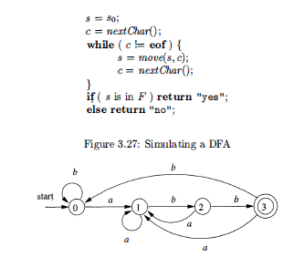
(a|b)* abb
ababb,
Sequence of states: 0, 1 , 2, 1 , 2, 3
& returns "yes."

Slide 65
Example
Draw the Transition Diagram for the DFA accepting all string with a substring 01.
1
0
0,1
Start
q₀
0
q₂
1
q₁
A=({q₀,q₁,q₂},{0,1}, δ ,q₀,{q₁})
Check with the string 01,11010,100011, 0111,110101,11101101, 111000

Slide 66
Transition Function & Table
1
0
0,1
Start
q₀
0
q₂
1
q₁
(q₀,0)=q₂
(q₀,1)=q₀
(q₁,0)=q₁
(q₁,1)=q₁
(q₂,0)=q₂
(q₂,1)=q₁
 | 0 | 1
→q₀ *q₁ q₂ | q₂ q₁ q₂ | q₀ q₁ q₁

Slide 67
Example
Let us design a DFA to accept the language
L={w | w has both an even number of 0’s and even number of 1’s}
q₀→0(even) 1 (even)
q₁→0(even) 1 (odd)
q₂→0(odd) 1 (even)
q₃→0(odd) 1 (odd)
1
Start
q
q
0
1
1
 | 0 | 1
*q₀ q₁ q₂ q₃ | q₂ q₃ q₀ q₃ | q₁ q₀ q₃ q₁
0
0
0
0
1
q
q
2
3
1

Slide 68
Example: Try Yourself
A = {w | w contains at least one 1 and an even number of 0s follow the last 1
Hints: A₁ = (Q, ∑, δ, q₁, F)
Q = {q₁, q₂, q₃}
∑ = {0, 1}
δ try yourself
Start state: q₁
Final state: {q₂}

Slide 69
Example
0
1
1
q₁
q₂
0
A₂= ({q₁, q₂}, (0,1), δ, q₁, {q₂})
Transition function, δ
 | 0 | 1
→q₁ *q₂ | q₁ q₁ | q₂ q₂
Try: 1101, 11010, 0011010
L(A2) = {w | w ends in a 1}
69

Slide 70
Example
0
1
1
q₁
q₂
0
A₃= ({q₁, q₂}, (0,1), δ, q₁, {q₁})
Transition function, δ
 | 0 | 1
→*q₁ q₂ | q₁ q₁ | q₂ q₂
Try: 1101, 11010, 0011010
L(A₃) = {w | w is ε or ends
in a 0}
70

Slide 71
DFA vs. NFA
DFA: δ returns a single state
Every state of a DFA always has exactly one exiting transition arrow for each symbol in the alphabet
Labels on the transition arrows are symbols from the alphabet
NFA: δ returns a set of states
NFA has an arrow with label ∈
NFA may have arrows labeled with members of alphabet/∈.
Zero, one, or many arrows may exit from each state with label ∈

Slide 72
DFA vs. NFA
Parallel computation
tree
reject
Accept/reject
accept

Slide 73
NFA to DFA
Subset Construction Algorithm

Slide 74
Subset Construction
Given an NFA with states Q, inputs Σ, transition function δ_{N}, start state q₀, and final states F, construct equivalent DFA with:
States 2^{Q} (Set of subsets of Q).
Inputs Σ.
Start state {q₀}.
Final states = all those with a member of F.

Slide 75
Subset Construction
Given, NFA: N = (Q_{N}, Σ, δ_{N}, q₀, F_{N})
Goal: DFA, D = (Q_{D}, Σ, δ_{D}, {q₀}, F_{D})
L(D) = L(N)
States
Q_{D} is the set of subsets of Q_{N}
Q_{D} is the power set of Q_{N}
If Q_{N} has n states, Q_{D} will have 2^{n} states
Inaccessible states can be thrown away, so effectively, the number of states D << 2^{n}

Slide 76
Subset construction
Final States
F_{D} is the set of subsets S of Q_{N} such that S ∩ F_{N} ≠ ∅ . That is F_{D} is all sets of N’s states that include at least one accepting state of N.
Transition Function
The transition function δ_{D} is defined by:
δ_{D}({q₁,…,q_{k}}, a) is the union over all i = 1,…,k of δ_{N}(q_{i}, a).

Slide 77
Subset Construction: Example 1
Example: We’ll construct the DFA equivalent of our “chessboard” NFA.
1
2
3
4
5
6
7
8
9

Slide 78
Example: Subset Construction
r b
2,4 5
4,6 1,3,5
2,6 5
2,8 1,5,7
2,4,6,8 1,3,7,9
2,8 3,5,9
4,8 5
4,6 5,7,9
6,8 5
r b
{1}
{2,4} {5}
{2,4}
{5}
*

Slide 79
Example: Subset Construction
r b
2,4 5
4,6 1,3,5
2,6 5
2,8 1,5,7
2,4,6,8 1,3,7,9
2,8 3,5,9
4,8 5
4,6 5,7,9
6,8 5
r b
{1}
{2,4} {5}
{2,4}
{2,4,6,8} {1,3,5,7}
{5}
{2,4,6,8}
{1,3,5,7}
*

Slide 80
Example: Subset Construction
r b
2,4 5
4,6 1,3,5
2,6 5
2,8 1,5,7
2,4,6,8 1,3,7,9
2,8 3,5,9
4,8 5
4,6 5,7,9
6,8 5
r b
{1}
{2,4} {5}
{2,4}
{2,4,6,8} {1,3,5,7}
{5}
{2,4,6,8} {1,3,7,9}
{2,4,6,8}
{1,3,5,7}
* {1,3,7,9}
*

Slide 81
Example: Subset Construction
r b
2,4 5
4,6 1,3,5
2,6 5
2,8 1,5,7
2,4,6,8 1,3,7,9
2,8 3,5,9
4,8 5
4,6 5,7,9
6,8 5
r b
{1}
{2,4} {5}
{2,4}
{2,4,6,8} {1,3,5,7}
{5}
{2,4,6,8} {1,3,7,9}
{2,4,6,8}
{2,4,6,8} {1,3,5,7,9}
{1,3,5,7}
* {1,3,7,9}
* {1,3,5,7,9}
*

Slide 82
Example: Subset Construction
r b
2,4 5
4,6 1,3,5
2,6 5
2,8 1,5,7
2,4,6,8 1,3,7,9
2,8 3,5,9
4,8 5
4,6 5,7,9
6,8 5
r b
{1}
{2,4} {5}
{2,4}
{2,4,6,8} {1,3,5,7}
{5}
{2,4,6,8} {1,3,7,9}
{2,4,6,8}
{2,4,6,8} {1,3,5,7,9}
{1,3,5,7}
{2,4,6,8} {1,3,5,7,9}
* {1,3,7,9}
* {1,3,5,7,9}
*

Slide 83
Example: Subset Construction
r b
2,4 5
4,6 1,3,5
2,6 5
2,8 1,5,7
2,4,6,8 1,3,7,9
2,8 3,5,9
4,8 5
4,6 5,7,9
6,8 5
r b
{1}
{2,4} {5}
{2,4}
{2,4,6,8} {1,3,5,7}
{5}
{2,4,6,8} {1,3,7,9}
{2,4,6,8}
{2,4,6,8} {1,3,5,7,9}
{1,3,5,7}
{2,4,6,8} {1,3,5,7,9}
* {1,3,7,9}
{2,4,6,8} {5}
* {1,3,5,7,9}
*

Slide 84
Example: Subset Construction
r b
2,4 5
4,6 1,3,5
2,6 5
2,8 1,5,7
2,4,6,8 1,3,7,9
2,8 3,5,9
4,8 5
4,6 5,7,9
6,8 5
r b
{1}
{2,4} {5}
{2,4}
{2,4,6,8} {1,3,5,7}
{5}
{2,4,6,8} {1,3,7,9}
{2,4,6,8}
{2,4,6,8} {1,3,5,7,9}
{1,3,5,7}
{2,4,6,8} {1,3,5,7,9}
* {1,3,7,9}
{2,4,6,8} {5}
* {1,3,5,7,9}
{2,4,6,8} {1,3,5,7,9}
*

Slide 85
Example 2
0,1
Start
q₀
0
q₁
1
q₂
δ_{D}({q₀, q₂}, 0) = δ_{N}({q₀, 0) U δ_{N}({q₂, 0) = {q₀, q₁} U ∅ = {q₀, q₁}
δ_{D}({q₀, q₂}, 1) = δ_{N}({q₀, 1) U δ_{N}({q₂, 1) = {q₀} U ∅ = {q₀}
 | 0 | 1
Ø →{q₀} {q₁} *{q₂} {q₀,q₁} *{q₀,q₂} *{q₁,q₂} *{q₀,q₁,q₂} | Ø {q₀,q₁} Ø Ø {q₀,q₁} {q₀,q₁} Ø {q₀,q₁} | Ø {q₀} {q₂} Ø {q₀,q₂} {q₀} {q₂} {q₀,q₂}

Slide 86
Example 2
 | 0 | 1
A | A | A
→B | E | B
C | A | D
*D | A | A
E | E | F
*F | E | B
*G | A | D
*H | E | F
NFA N Accepts all strings that end in 01
N’s set of states: {q₀, q₁, q₂} =03
Subset construction: DFA need 2³ = 8 states
Assign new names: A for ∅ , B for {q₀}

Slide 87
Example 2
1
0
Start
B
0
E
1
F
0
 | 0 | 1
A | A | A
→B | E | B
C | A | D
*D | A | A
E | E | F
*F | E | B
*G | A | D
*H | E | F
1
From 08 states, starting in start state B, can only reach states B, E & F
other 05 states are inaccessible from B

Slide 88
Example 3
N = (Q, {a, b}, δ, 1, {1})
Q = {1, 2, 3} = 03 states
DFA states = 08
{∅, {1}, {2}, {3}, {1, 2}, {1, 3}, {2, 3}, {1, 2, 3}}
1
a
b
∈
2
3
a
a, b

Slide 89
 | a | b | ε
∅ | ∅ | ∅ | ∅
{1} | ∅ | {2} | {3}
{2} | {2, 3} | {3} | ∅
{3} | {1, 3} | ∅ | ∅
{1, 2} | {2, 3} | {2, 3} | ∅
{1, 3} | {1, 3} | {2} | ∅
{2, 3} | {1, 2, 3} | {3} | ∅
{1, 2, 3} | {1, 2, 3} | {2, 3} | ∅
a, b
b
{2}
∅
a
{1}
{1, 2}
a
a, b
b
b
b
a
a
{3}
{1, 3}
{2, 3}
{1, 2, 3}
a
a
b
b

Slide 90
Example 3
Simplified: no incoming arrows point at states {1} & {1, 2}
May be removed without affecting the performance
a, b
a
a
{3}
b
∅
{1, 3}
b
b
b
a
{2, 3}
a
{2}
{1, 2, 3}
a
b

Slide 91
Closure of States
CL(q) = set of states you can reach from state q following only arcs labeled ε.
Example: CL(A) = {A};
CL(E) = {B, C, D, E}.
Closure of a set of states = union of the closure of each state.
ε
1
1
1
B
C
D
A
ε
ε
0
0
E
F
0

Slide 92
Algorithm : The subset construction of a DFA from an NFA.
Input: An NFA N.
OUTPUT: A DFA D accepting the same language as N
METHOD: constructs a transition table Dtran for D.
Each state of D is a set of NFA states, and construct Dtran so D will simulate
"in parallel" all possible moves N can make on a given input string.
s is a single state of N, while T is a set of states of N.

Slide 93
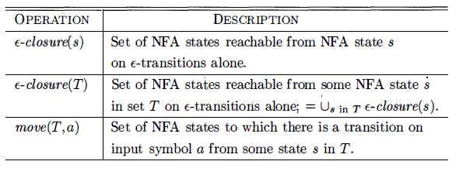
Operations on NFA states
Set of states

Slide 94
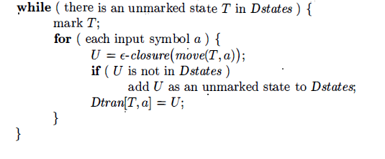
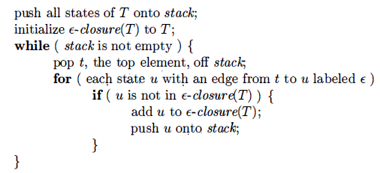
The subset construction
Computing ε-closure(T)

Slide 95
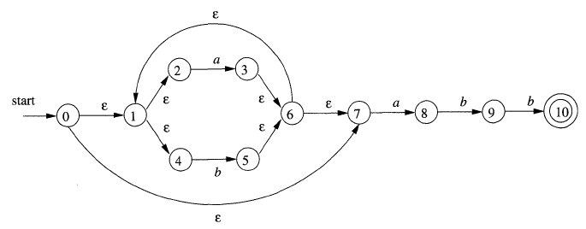
Example: NFA accepting R = (alb) *abb

Slide 96
Σ = (a, b)
Marked
ε-closure(0) = {0, 1, 2,4, 7} = A
Mark A, Compute Dtran [A, a] & Dtran [A, b]
Dtran [A, a] = ε-closure (move(A, a))
= ε-closure (move({0, 1, 2, 4, 7}, a))
= ε-closure ({3, 8})
= {3, 6, 7, 1, 2, 4} U {8}
= {1, 2, 3, 4, 6, 7, 8} = B

Slide 97
Σ = (a, b)
Dtran [A, b] = ε-closure (move(A, b))
= ε-closure (move({0, 1, 2, 4, 7}, b))
= ε-closure ({5})
= {5, 6, 7, 1, 2, 4}
Dtran [A, b] = {1, 2, 4, 5, 6, 7} = C

Slide 98
Σ = (a, b)
Mark B, Compute Dtran [B, a] & Dtran [B, b]
Dtran [B, a] = ε-closure (move(B, a))
= ε-closure (move({1, 2, 3, 4, 6, 7, 8}, a))
= ε-closure ({3, 8})
= {3, 6, 7, 1, 2, 4} U {8}
Dtran [B, a] = {1, 2, 3, 4, 6, 7, 8} = B

Slide 99
Σ = (a, b)
Compute Dtran [B, b]
Dtran [B, b] = ε-closure (move(B, b))
= ε-closure (move({1, 2, 3, 4, 6, 7, 8}, b))
= ε-closure ({5, 9})
= {5, 6, 7, 1, 2, 4} U {9}
Dtran [B, b] = {1, 2, 4, 5, 6, 7, 9} = D

Slide 100
Σ = (a, b)
Mark C, Compute Dtran [C, a] & Dtran [C, b]
Dtran [C, a] = ε-closure (move(C, a))
= ε-closure (move({1, 2, 4, 5, 6, 7}, a))
= ε-closure ({3, 8})
= {3, 6, 7, 1, 2, 4} U {8}
Dtran [C, a] = {1, 2, 3, 4, 6, 7, 8} = B

Slide 101
Σ = (a, b)
Compute Dtran [C, b]
Dtran [C, b] = ε-closure (move(C, b))
= ε-closure (move({1, 2, 4, 5, 6, 7}, b))
= ε-closure ({5})
= {5, 6, 7, 1, 2, 4}
Dtran [C, b] = {1, 2, 4, 5, 6, 7} = C

Slide 102
Σ = (a, b)
Mark D, Compute Dtran [D, a] and Dtran [D, b]
Dtran [D, a] = ε-closure (move(D, a))
= ε-closure (move({1, 2, 4, 5, 6, 7, 9}, a))
= ε-closure ({3, 8})
= {3, 6, 7, 1, 2, 4} U {8}
Dtran [D, a] = {1, 2, 3, 4, 6, 7, 8} = B

Slide 103
Σ = (a, b)
Compute Dtran [D, b]
Dtran [D, b] = ε-closure (move(D, b))
= ε-closure (move({1, 2, 4, 5, 6, 7, 9}, b))
= ε-closure ({5, 10})
= {5, 6, 7, 1, 2, 4} U {10}
Dtran [D, b] = {1, 2, 4, 5, 6, 7, 10} = E

Slide 104
Σ = (a, b)
Mark E, Compute Dtran [E, a] and Dtran [E, b]
Dtran [E, a] = ε-closure (move(E, a))
= ε-closure (move({1, 2, 4, 5, 6, 7, 10}, a))
= ε-closure ({3, 8})
= {3, 6, 7, 1, 2, 4} U {8}
Dtran [E, a] = {1, 2, 3, 4, 6, 7, 8} = B

Slide 105
Σ = (a, b)
Compute Dtran [E, b]
Dtran [E, b] = ε-closure (move(E, b))
= ε-closure (move({1, 2, 4, 5, 6, 7, 10}, b))
= ε-closure ({5})
= {5, 6, 7, 1, 2, 4}
Dtran [E, b] = {1, 2, 4, 5, 6, 7} = C

Slide 106
Summary
Dtran [A, a] = {1, 2, 3, 4, 6, 7, 8} = B
Dtran [A, b] = {1, 2, 4, 5, 6, 7} = C
Dtran [B, a] = {1, 2, 3, 4, 6, 7, 8} = B
Dtran [B, b] = {1, 2, 4, 5, 6, 7, 9} = D
Dtran [C, a] = {1, 2, 3, 4, 6, 7, 8} = B
Dtran [C, b] = {1, 2, 4, 5, 6, 7} = C
Dtran [D, a] = {1, 2, 3, 4, 6, 7, 8} = B
Dtran [D, b] = {1, 2, 4, 5, 6, 7, 10} = E
Dtran [E, a] = {1, 2, 3, 4, 6, 7, 8} = B
Dtran [E, b] = {1, 2, 4, 5, 6, 7} = C
NFA State | DFA State | a | b
{0, 1, 2, 4, 7} | A | B | C
{1, 2, 3, 4, 6, 7, 8} | B | B | D
{1, 2, 4, 5, 6, 7} | C | B | C
{1, 2, 4, 5, 6, 7, 9} | D | B | E
{1, 2, 4, 5, 6, 7, 10} | E | B | C

Slide 107
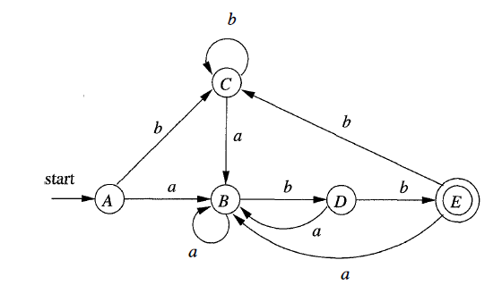
NFA State | DFA State | a | b
→{0, 1, 2, 4, 7} | →A | B | C
{1, 2, 3, 4, 6, 7, 8} | B | B | D
{1, 2, 4, 5, 6, 7} | C | B | C
{1, 2, 4, 5, 6, 7, 9} | D | B | E
*{1, 2, 4, 5, 6, 7, 10} | *E | B | C

Slide 108
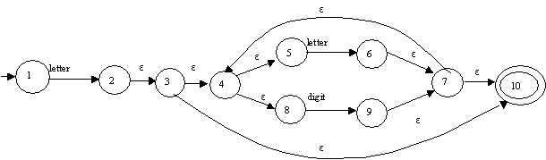

Slide 109
Regular Expression to NFA
McNaughton-Yamada-Thompson Algorithm

Slide 110
Construction of an NFA from a Regular Expression
Algorithm: The McNaughton-Yamada- Thompson algorithm to convert a regular expression to an NFA.
INPUT: A regular expressioll r over alphabet Σ
OUTPUT: An NFA N accepting L(r) .
METHOD:
Begin by parsing r into its constituent sub expressions.
The rules for constructing an NFA consist of
basis rules for handling sub expressions with no operators,
inductive rules for constructing larger NFA's from the NFA's for the immediate sub expressions of a given expression

Slide 111


Basis
For expression ε (r= ε) construct the NFA
For any sub expression a (r=a), construct NFA

Slide 112
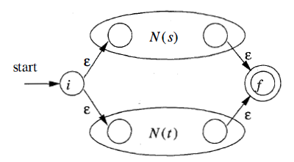
INDUCTION
Suppose N(s) and N(t) are NFA's for regular expressions s and t, respectively.
r = s|t (union)

Slide 113

2. r = st (Concatenation)

Slide 114
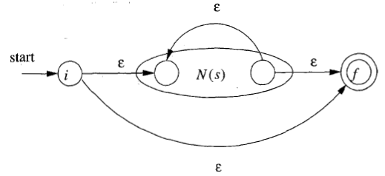
3. r = s* (Closure/star)

Slide 115
Observations
1. N(r) has at most twice as many states as there are operators and operands in r.
-This bound follows from the fact that each step of the algorithm creates at most two new states.
2. N(r) has one start state and one accepting state.
-The accepting state has no outgoing transitions,
-start state has no incoming transitions.
3. Each state of N(r) other than the accepting state has either
-one outgoing transition on a symbol in Σ
-or two outgoing transitions, both on ε

Slide 116
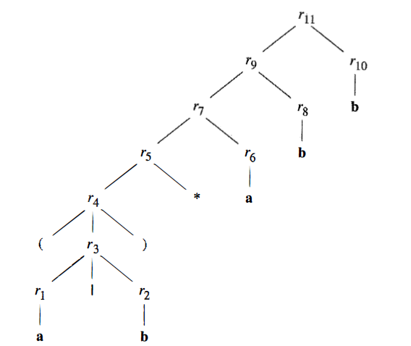
Example: Construct an NFA for r = (alb)*abb
Parse tree

Slide 117


Step 1: For sub expression r₁ = a
Step 2: For sub expression r₂ = b

Slide 118
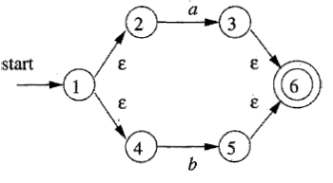
Step 3: For sub expression r₃ = r₁|r₂
Step 4: For sub expression r₄ = (r₃)
Same As r₃

Slide 119
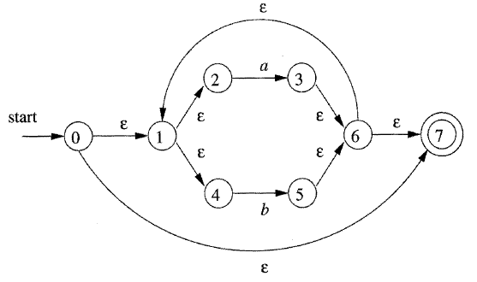
Step 5: For sub expression r₅ = (r₃)*

Slide 120

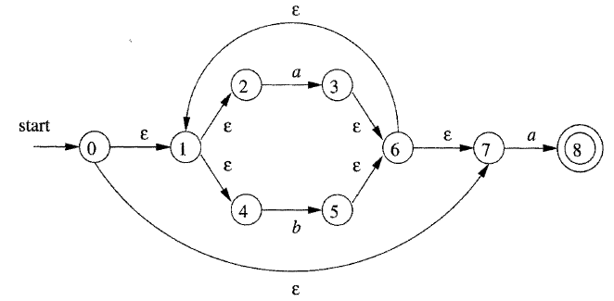
Step 6: For sub expression r₆ = a
Step 7: For sub expression r₇ = r₅r₆

Slide 121
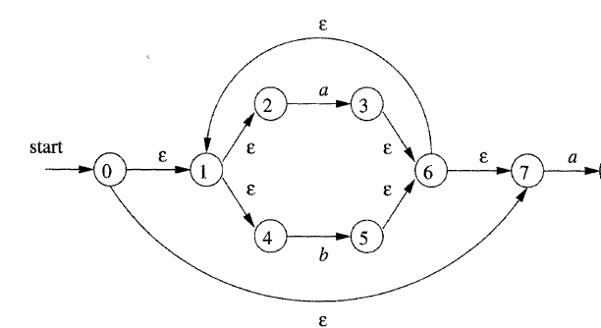
Step 8: For sub expression r₈ = b
8`
b
9
Step 9: For sub expression r₉ = r₈r₇
8
b
9

Slide 122
Step 9: For sub expression r₁₀ = b
9`
b
10
Step 10: For sub expression r₁₁ = r₁₀r₉
8
b
9
b
10

Slide 123
Important States of NFA
A state of an NFA important if it has a non-ε out-transition.
Notice that the subset construction uses only the important states in a set T when it computes
ε- closure (move(T, a)),
-the set of states reachable from T on input a.
The set of states move(s , a) is nonempty only if state s is important.
During the subset construction, two sets of NFA states can be identified (treated as if they were the same set) if they:
1. Have the same important states, and
2. Either both have accepting states or neither does.

Slide 124
The only important states are those introduced as initial states in the basis part for a particular symbol position in the regular expression.
Each important state corresponds to a particular operand in the regular expression.
The constructed NFA has only one accepting state, but this state, having no out-transitions, is not an important state
By concatenating a unique right end marker # to a regular expression r, we give the accepting state for r a transition on #, making it an important state of the NFA for (r) #.
augmented regular expression (r)#,
when the construction is complete, any state with a transition on # must be an accepting state.

Slide 125
Nodes
The important states of the NFA correspond directly to the positions in the regular expression that hold symbols
present the regular expression by its syntax tree
-leaves correspond to operands
-interior nodes correspond to operators
An interior nodes:
cat-node: concatenation operator (.dot)
or-node: union operator (I)
star-node: star operator (*)

Slide 126
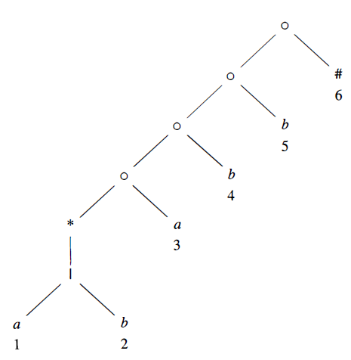
Syntax tree: (alb)* abb#

Slide 127
Syntax tree: (alb)* abb#
Leaves in a syntax tree are labeled by ε or by an alphabet symbol.
To each leaf not labeled ε, attach a unique integer.
(the position of the leaf and also as a position of its symbol)
a symbol can have several positions (a: 1 & 3 )
The positions in the syntax tree correspond to the important states of the constructed NFA.

Slide 128
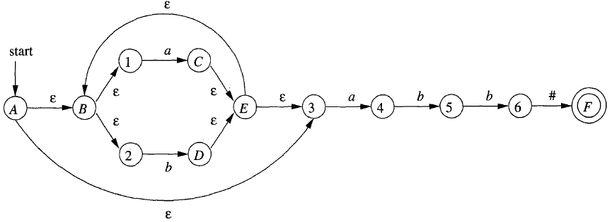
Example: NFA [for r=(a|b)*abb#] with the important states numbered and other states represented by letters
8
b
9
b
10

Slide 129
Functions Computed From the Syntax Tree
To construct a DFA directly from a regular expression, we construct its syntax tree and then compute four functions:
nullable
firstpos
lastpos
followpos

Slide 130
04 Functions
nullable(n) is true for a syntax-tree node n if & only if the sub expression represented by n has ε in its language.
sub expressiorn can be "made null" or the empty string, even though there may be other strings it can represent as well.
2. firstpos(n) is the set of positions in the subtree rooted at n that correspond to the first symbol of at least one string in the language of the sub expression rooted at n.
3. lastpos(n) is the set of positions in the subtree rooted at n that correspond to the last symbol of at least one string in the language of the sub expression rooted at n
4. followpos(p), for a position p, is the set of positions q in the entire syntax tree such that there is some string x = a₁ a₂ . . . a_{n} in L ( (r ) #) such that for some i, there is a way to explain the membership of x in L( (r) #) by matching a_{i} to position p of the syntax tree and a_{i+1} to position q

Slide 131
Example: Consider the cat-node n corresponds to expression (alb) *a
nullable(n) is false, since this node generates all strings of a’s & b’s ending in an a; does not generate ε
the star-node below it is nullable; it generates ε along with all other strings of a’s & b’s
aa
ba
aba
Cat node
firstpos (n) = {1, 2, 3}
lastpost (n) = {3}
followpos (1) = {1, 2, 3}

Slide 132
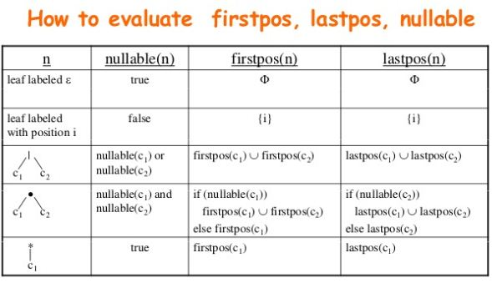
Computing nullable, firstpos, & lastpos
Compute nullable, firstpos, & lastpos by a straightforward recursion on height of the tree
Basis & inductive rules for nullable & firstpos

Slide 133
Example : only the star-node is nullable.
none of the leaves are nullable, because they each correspond to non-ε operands.
The or-node is not nullable, because neither of its children is.
The star-node is nullable, because every star-node is nullable.
each of the cat-nodes, having at least one non null able child, is not nullable.

Slide 134
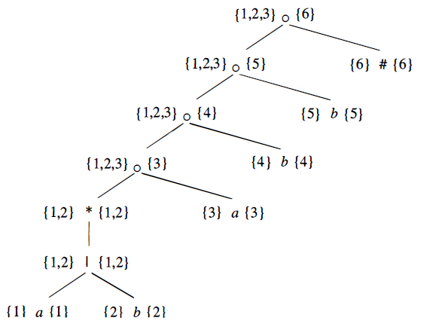
firstpos(n) to the left of node n, and lastpos(n) to its right. Each of the leaves has only itself for firstpos & lastpos, as required by the rule for non-ε leaves
For the or-node, we take the union of firstpos at the children and do the same for lastpos.

Slide 135
consider the lowest cat-node, which we shall call n.
To compute firstpos(n) , we first consider whether the left operand is nullable, which it is in this case.
Therefore, firstpos for n is the union of firstpos for each of its children, that is {1, 2 } U {3} = {I, 2, 3}.
The rule for lastpos are the same as for firstpos, with the children interchanged.
To compute lastpos(n) we must ask whether its right child (the leaf with position 3) is nullable, which it is not.
Therefore, lastpos(n) is the same as lastpos of the right child, or {3}.

Slide 136
Computing Followpos
two ways that a position of a regular expression can be made to follow another:
1. If n is a cat-node with left child C₁ & right child C₂ , then for every position i in lastpos(C₁) , all positions in firstpos(C₂) are in followpos(i).
2. If n is a star-node, & i is a position in lastpos(n) , then all positions in firstpos(n) are in followpos(i).

Slide 137
Example: Rule 1 for followpos requires that we look at each cat-node, & put each position in firstpos of its right child in followpos for each position in lastpos of its left child.
firstpos
lastpos

Slide 138
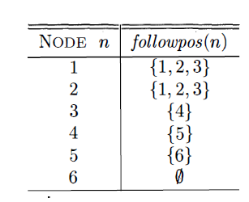
For the lowest cat-node, that rule says position 3 is in followpos(1) and followpos(2)
The next cat-node says that 4 is in followpos (3) ,
remaining two cat-nodes give us 5 in followpos (4) & 6 in followpos(5)
1. If n is a cat-node with left child C₁ & right child C₂ , then for every position i in lastpos(C₁) , all positions in firstpos(C₂) are in followpos(i).
C₁
C₂
F|L
F|L

Slide 139
For the lowest cat-node, that rule says position 3 is in followpos(1) & followpos(2)
Rule 2 to the star-node. positions 1 & 2 are in both followpos(1) & followpos(2) , since both firstpos & lastpos for this node are {1 , 2} .
2. If n is a star-node, & i is a position in lastpos(n) , then all positions in firstpos(n) are in followpos(i).
C₁
C₂
F|L
F|L

Slide 140
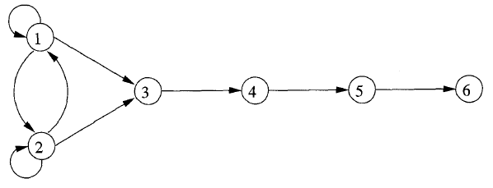
Directed graph for the function followpos

Slide 141
Converting a Regular Expression Directly to a DFA
Algorithm: Construction of a DFA from a regular expression r.
INPUT : A regular expression r.
OUTPUT: A DFA D that recognizes L (r) .
METHOD:
1 . Construct a syntax tree T from the augmented regular expression (r) #.
2. Compute nullable, firstpos, lastpos, & followpos for T
3. Construct Dstates, the set of states of DFA D , & Dtran, the transition function for D. The states of D are sets of positions in T. Initially, each state is "unmarked," & a state becomes "marked" just before we consider its out-transitions.
The start state of D is firstpos(n_{o}) , where node n_{o} is the root of T.
The accepting states are those containing the position for endmarker symbol #

Slide 142
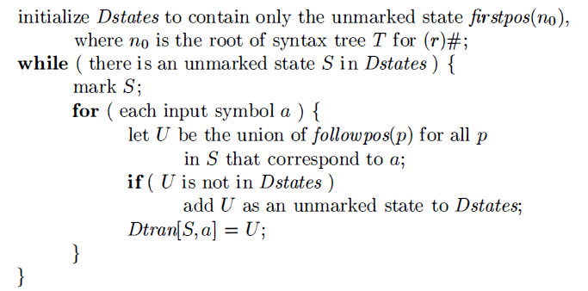
Construction of a DFA directly from a regular expression

Slide 143
Example: construct a DFA for the regular expression
r = (a|b)*abb.
The value of firstpos for the root of the tree: {1, 2, 3}
A = {1, 2, 3} ----Start state

Slide 144
Compute Dtran[A, a] & Dtran[A, b].
Among the positions of A, 1 & 3 correspond to a, while 2 corresponds to b.
Dtran[A, a] = followpos(1) U followpos(3) = {1, 2, 3, 4} = B

Slide 145
Compute Dtran[A, b].
Among the positions only 2 corresponds to b.
Dtran[A, b] = followpos(2) = {1, 2, 3} = A

Slide 146
Compute Dtran[B, a] = Dtran[{1, 2, 3, 4}, a]
Among the positions 1, 3 corresponds to a.
Dtran[B, a] = followpos(1) U followpos(3)
= {1, 2, 3, 4} = B

Slide 147
Compute Dtran[B, b] = Dtran[{1, 2, 3, 4}, b]
Among the positions 2 & 4 corresponds to b.
Dtran[B, b] = followpos(2) U followpos(4)
= {1, 2, 3, 5} = C

Slide 148
Compute Dtran[C, a] = Dtran[{1, 2, 3, 5}, a]
Among the positions 1 & 3 corresponds to a.
Dtran[C, a] = followpos(1) U followpos(3)
= {1, 2, 3, 4} = B

Slide 149
Compute Dtran[C, b] = Dtran[{1, 2, 3, 5}, b]
Among the positions 2 & 5 corresponds to b.
Dtran[C, b] = followpos(2) U followpos(5)
= {1, 2, 3, 6} = D

Slide 150
Compute Dtran[D, a] = Dtran[{1, 2, 3, 6}, a]
Among the positions 1 & 3 corresponds to a.
Dtran[D, a] = followpos(1) U followpos(3)
= {1, 2, 3, 4} = B

Slide 151
Compute Dtran[D, b] = Dtran[{1, 2, 3, 6}, b]
Among the positions 2 corresponds to b.
Dtran[D, b] = followpos(2)
= {1, 2, 3} = A

Slide 152
A = {1, 2, 3}
Dtran[A, a] = followpos(1) U followpos(3) = {1, 2, 3, 4} = B
Dtran[A, b] = followpos(2) = {1, 2, 3} = A
Dtran[B, a] = followpos(1) U followpos(3) = {1, 2, 3, 4} = B
Dtran[B, b] = followpos(2) U followpos(4) = {1, 2, 3, 5} = C
Dtran[C, a] = followpos(1) U followpos(3) = {1, 2, 3, 4} = B
Dtran[C, b] = followpos(2) U followpos(5) = {1, 2, 3, 6} = D
Dtran[D, a] = followpos(1) U followpos(3) = {1, 2, 3, 4} = B
Dtran[D, b] = followpos(2) = {1, 2, 3} = A
States |  | a | b
{1, 2, 3} | A | B | A
{1, 2, 3, 4} | B | B | C
{1, 2, 3, 5} | C | B | D
{1, 2, 3, 6} | D | B | A

Slide 153
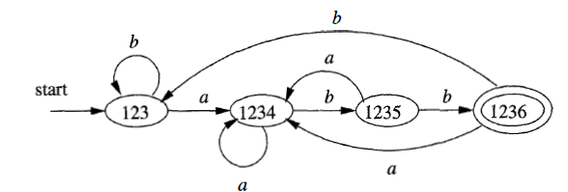
States |  | a | b
{1, 2, 3} | A | B | A
{1, 2, 3, 4} | B | B | C
{1, 2, 3, 5} | C | B | D
{1, 2, 3, 6} | D | B | A
DFA Construction
A
B
C
D

Slide 154
Assignment
1.(a|b)*a(a|b)
2.(a|b)*a(a|b)(a|b)
3.(a|b)*a(a|b)(a|b)(a|b)

Slide 155
Conclusion
Tokens
Lexemes
Patterns
Regular Expressions
Regular Definitions
Transition Diagrams
Finite Automata
DFA & NFA
Conversion (NFA to DFA, Regular Expression to NFA/DFA)

